Slide 1
Work-Plan For Rel-ID
Kuldeep Singh - Mentor
Patrick Seume - Member
Kai Kenklies - Member
Victor Ouko - Member

Slide 2
Work-Plan
Dates | Tasks
(July 11th–July25th) (July 26th–Aug 3rd) (Aug 4th-Aug 18th) | Get the first draft of the project running, specifically the parser and relation matcher. The parser should be able to (with high probability) extract relations from given queries. The relation matcher should match simple queries to relations. Write test cases for our application. Improve the relation matcher; specifically attempt to incorporate part-of-speech tags.

Slide 3
Work-Plan
Dates | Tasks
(Aug 19th–Sept 1st) (Sept 2nd–Sept 9th) (Sept 12th-Sept 19th) | Explore various ways in which we could improve the matcher; specifically focusing on efficiency; this being the percentage of correctly matched relations. Documentation of the project. Development of project Poster.

Slide 4
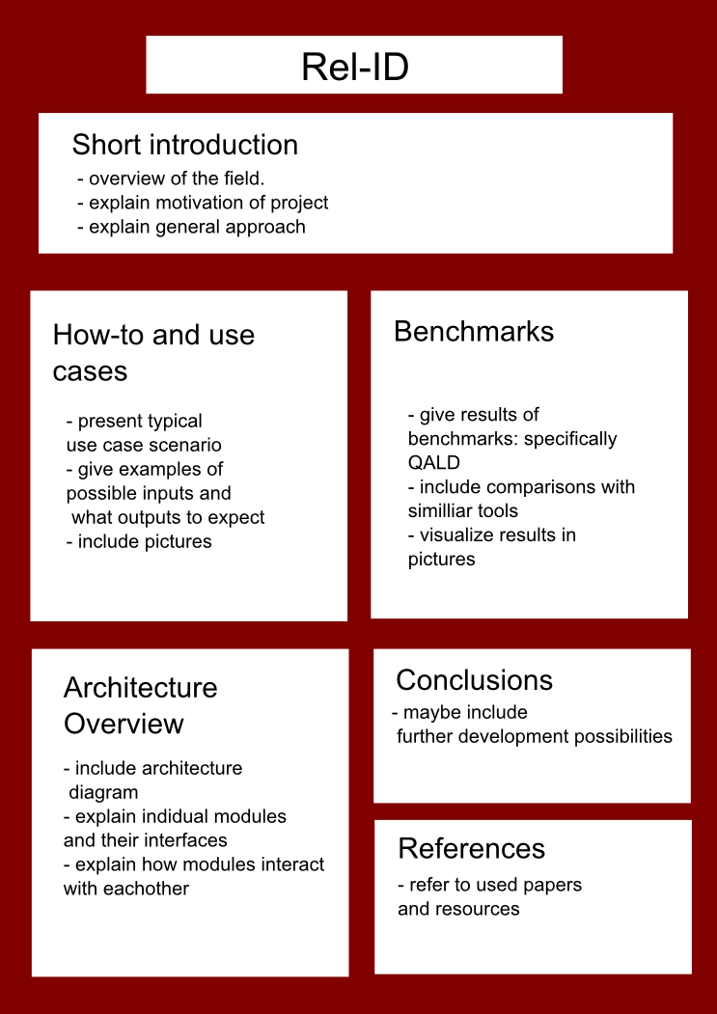

Slide 5
Remarks On Poster
No need for references.
Include login and password for virtual machine.
Include the challenges we faced in the project

Slide 6


